Slide 1
Visioning with recreation… A look into the future
Marybeth Mabry, Town Council

Slide 2
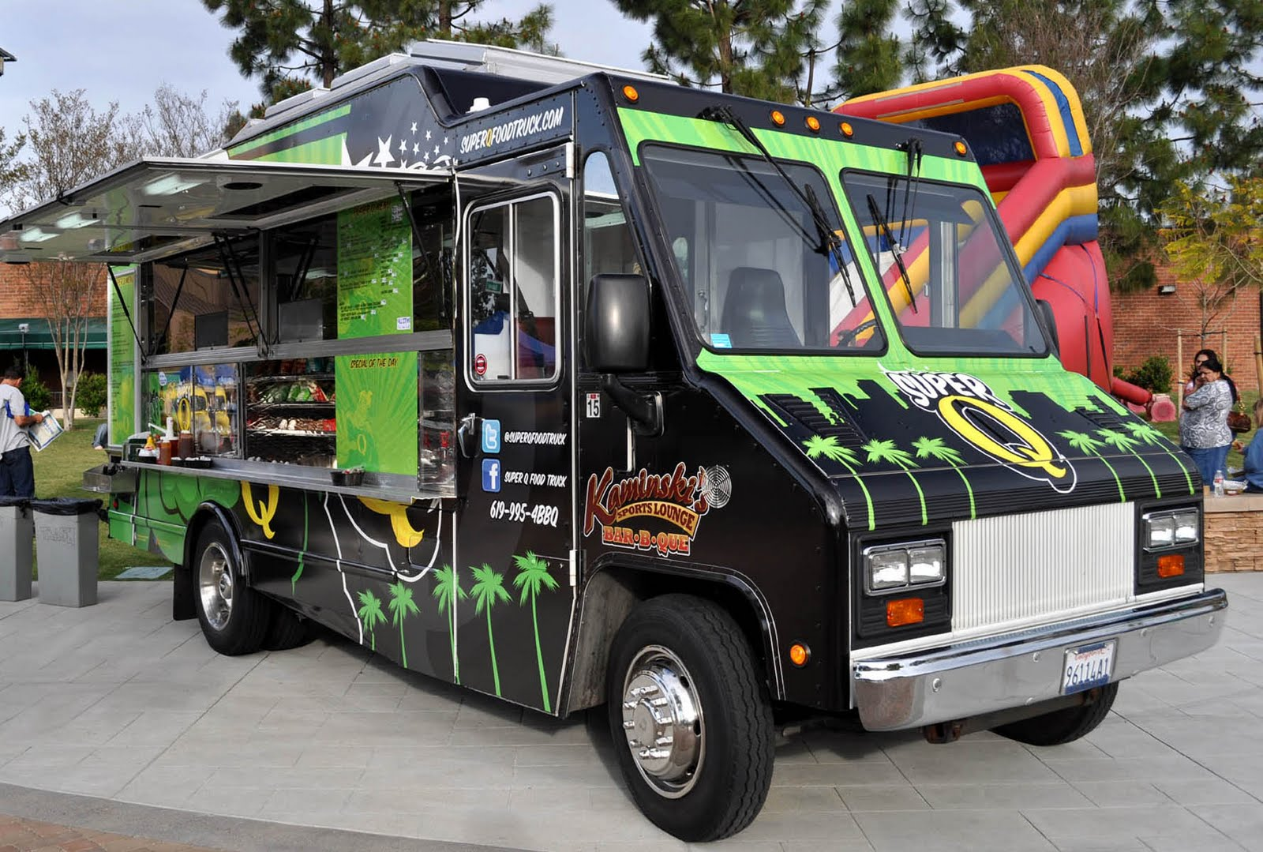
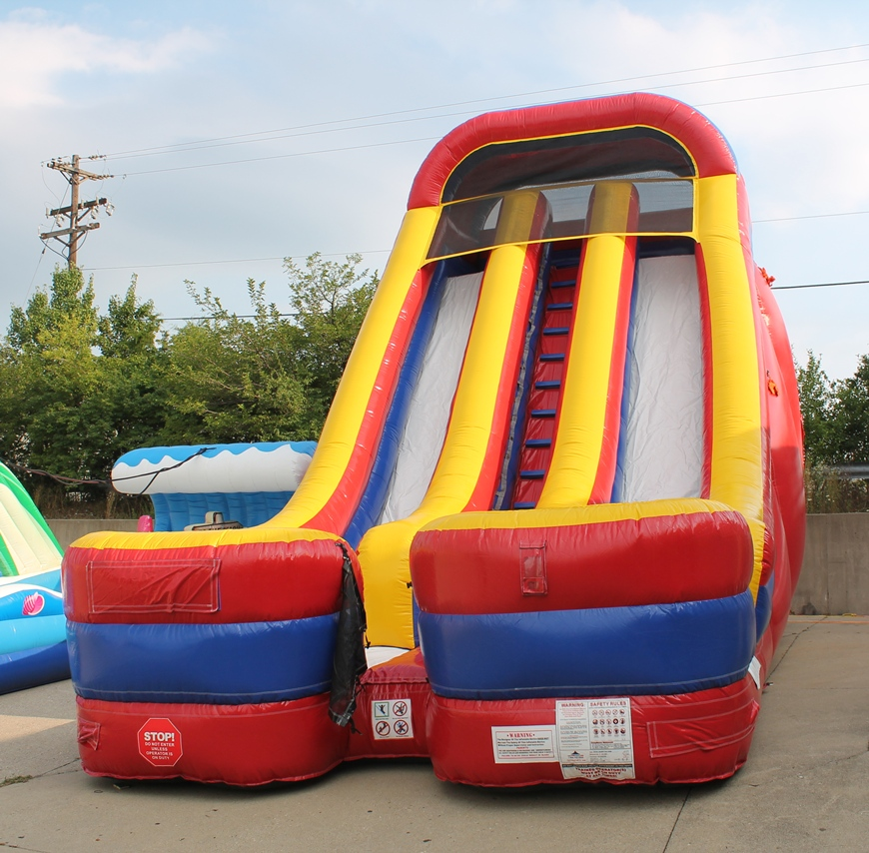
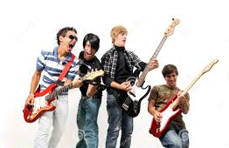
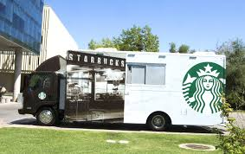
SPECIAL EVENTS… MAKING AN IMPACT
“Tasty Tuesdays” – Once a month incorporate a fun and entertaining event that compliments the Farmers Market and creates a full day of activities for visitors and citizens alike.
Allow food trucks (Tasty Tuesday’s only)
Have live music; bands that want the opportunity to be heard
Kids activities (creative art camps, inflatables)
Art displays and exhibits around the park
Create a fun day that allows the opportunity for visitors to see what Surfside Beach has to offer.

Slide 3
City of Greenville, SC - Mice on Main
To find the mice, you'll need the Mice on Main set of clues- if you plan to find them all. Here are some hints we created just for you. 1. Begin your search on North Main outside of the hotel restaurant where a fountain makes a wall of water. You'll find the father mouse, Marvin, reading his book. He can't hide--take a good look! 2. Mother Maggie is just across, sitting where she can see Marvin. When she looks down the street, she can see their five baby mice, placed here and there, all so sweet. 3. Cross the street and walk a bit. You'll see Marvin, Jr. at the top of the stairs where coffee lovers and computer gurus meet and poets love to count their feet. 4. Marcley's somewhere near the One Main Street plaza. Look around. You'll find him there. 5. Millie's a high "high-tech" girl. You'll really have to search, but give it a whirl. 6. Watch out! Mitch does his skateboarding in the bank's alley. You'll be lucky to find him; don't dally. 7. Across the street there's healthy stuff along the way. That's where Melissa loves to play. 8. You'll find Aunt Mifflin where there's money. She's looking at the flowers, honey. 9. Mifflin's husband, Uncle Miles, loves to eat Italian. He's by the rain spout. If you've found him, give a shout! That's what a mouse hunt is all about!

Slide 4
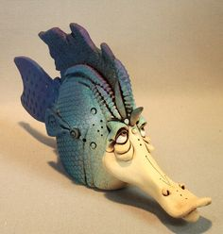
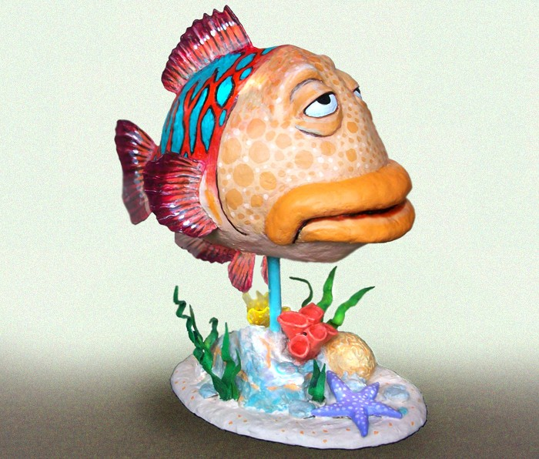
Make a wish then find the fish in Surfside Beach….
To find the fish, you'll need the ”Make a wish then find the fish” set of clues-if you plan to find them all. Here are some hints we created just for you.
Design a list of clues that take the visitors and citizens alike to different areas of the town…
Library
Parks
Beach
Historical sites
Lakes, etc.
This gives the visitors the opportunity to explore our town and discover we have more than just the beach to offer. It could be a year around adventure just as it is for Greenville!

Slide 5
Leave nothing but Footprints….

Slide 6
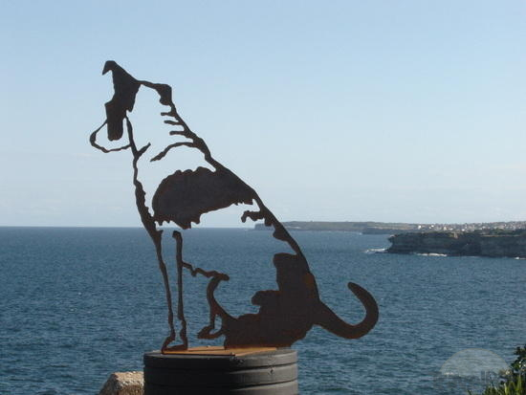
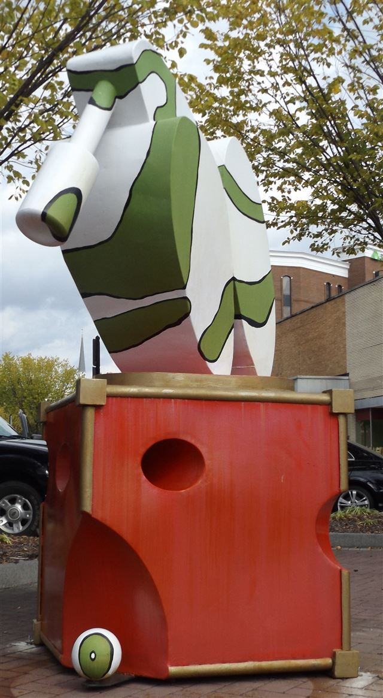
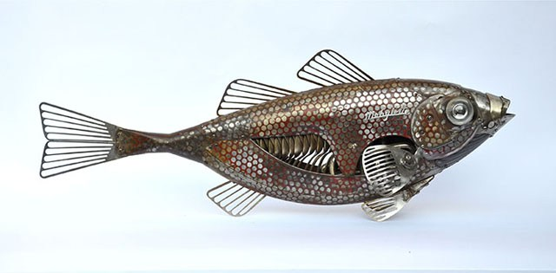
Bring Cultural Art to Surfside Beach…
Install new sculptures in the downtown area and all around town as part of a town “Sculpture Walk” program.
Establish a timeline to add additional sculptures to the town and create a walking brochure to give to visitors of the town.
Promote “Art in the Park” and “Art under the Oaks”. Provide festivals that highlight cultural activities within the town.

Slide 7
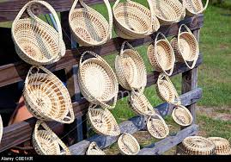
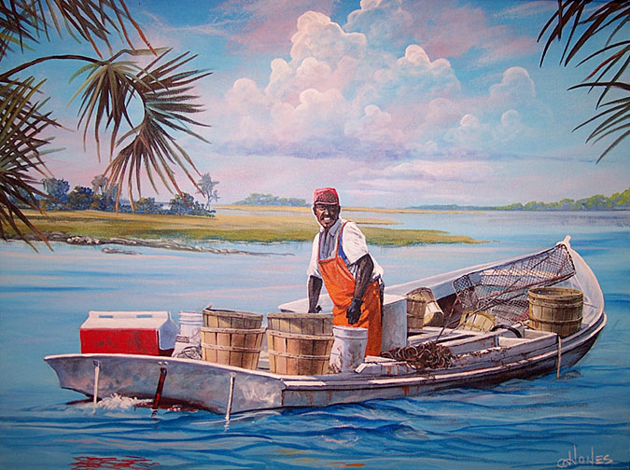
Fewer Festivals with more to offer….
Halloween Rod Run Car show – incorporate with the Bar-B-Que festival
Family Festival – incorporate Beach Luau for an all day and night fall event (require vendors be retail or in the food industry)
Easter Egg hunt – incorporate with the Kids Fair add art, make it a full day activity.
Fall Fishing Rodeo – Partner with local hotels for package deals
Skyhoundz Disc Contest – incorporate with the Pet Fair and invite vendors that specialize in pet products
Heritage Days – include Gullah Art festivities with basket makers - make it a full two day event.

Slide 8
Questions?

